Slide 1
Please keep microphones on mute
Please use chat box for questions to be answered at the end
PowerPoint will be available on our website https://mhanortheastindiana.org
Guardianship referral information available at https://mhanortheastindiana.org
2024

Slide 2
GUARDIANSHIP
LUNCH & LEARN
2024

Slide 3
MHANI HISTORY
Mental Health America was started in 1909 by Clifford Beers.​
He suffered from chronic mental illness and was placed in institutions where he experienced horrible atrocities.​ He dedicated his life to building an organization that would:​
Improve attitudes toward people with mental illness​
Improve services for people with mental illness​
Work for the prevention of mental illnesses​
Promote good mental health​
Mental Health America called upon asylums to discard the chains and shackles, which MHA melted down these bindings and recast them into a sign of hope: The Mental Health Bell.

Slide 4
MEET OUR GUARDIANSHIP TEAM
THE DIRECTORS
TARA HOLIDAY
JOSEPH BLAZIER
Executive Director Of Mental Health America of NE IN
Director of Guardianship Services

Slide 5
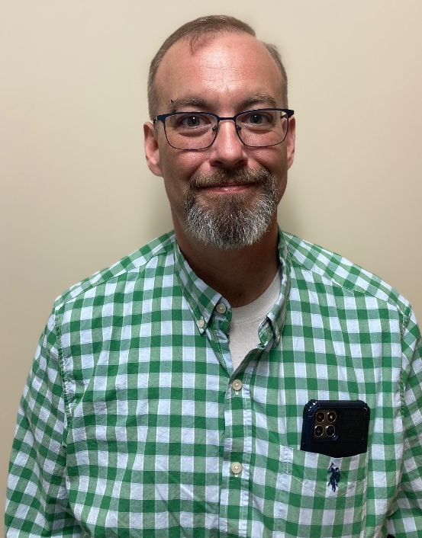
MEET OUR GUARDIANSHIP TEAM
Guardians Of the Galaxy
ANDREW HERMAN-KENDALL
DARAH HERRON
ASHLI WILT
NANCY HERMAN-KENDALL
Guardian
Guardian
Guardian
Guardian

Slide 6
MEET THE TEAM
ANDREW
DARAH
ASHLI
NANCY
Andrew joined the guardian team in 2024, after a 25-year-long career as a funeral director in Louisville, KY, and Fort Wayne. His focus is on helping those in the community that need support and caring for clients so they can have the best life possible.
Darah Is a board-certified music therapist and worked as a Music Therapist for several years. She has a
background working in hospice and as a Memory Care Director in nursing
facilities in Northeast Indiana.
She obtained her Social
Service Designee and became a Certified Dementia
Practitioner/Trainer.
She started with MHANI as a guardian in 2022.
Ashli joined the guardianship team in 2021. She also assists with volunteer coordination for the department. Prior to this position with MHANI, she
worked with adults with disabilities in various
Roles, and with children with disabilities in special
education settings. Ashli is proud to provide
advocacy and support to vulnerable individuals in
our community.
Nancy joined MHANI in 2009 in MHANI’s Supportive Living program, Cedars
Hope, which provided permanent housing for mentally ill women at risk of homelessness. She joined the Guardianship Department in 2018 and became a Nationally Certified Guardian. Her focus is to assist her clients with making the most independent life
choices.

Slide 7
WHAT IS GUARDIANSHIP?
GUARDIANSHIP
WHO NEEDS A GUARDIAN
Guardianship is the legal process where a court deems an individual incapacitated based on information provided by a medical physician. The court then decides who will make the best decisions for the incapacitated adult. These decisions may include choosing service providers, diet, housing, medical decisions and finances.
​
​
An incapacitated individual is an adult, 18 years of age or older, who is unable to manage their own affairs because of mental health disorders, intellectual/developmental disability, or age-related illnesses.

Slide 8
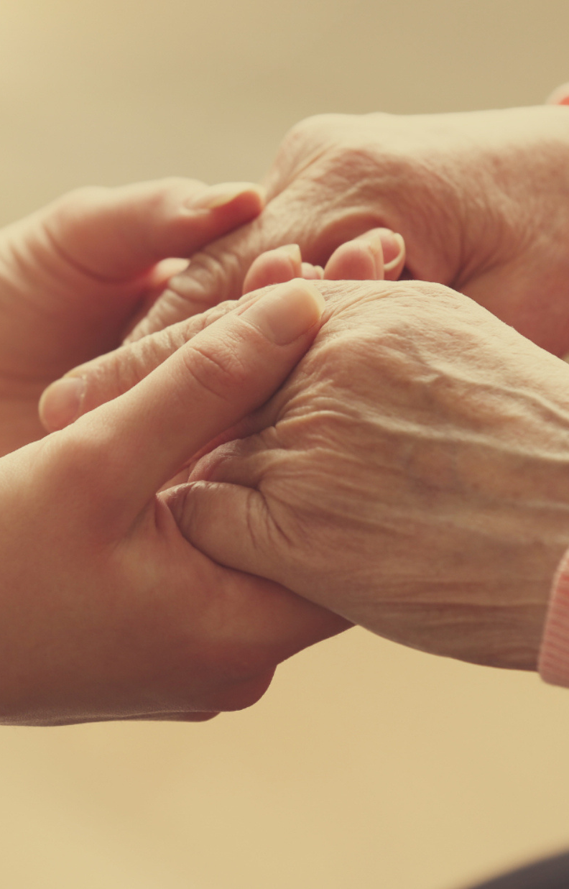
MHANI'S REFERRAL ELIGIBILITY REQUIREMENTS:
18 years of age or older​
Living in a 24/7 staffed setting​
Receiving Medicaid benefits​
No other family or friends able to serve as guardian​
We will help you decide if the client meets criteria for guardianship or if there are alternatives to guardianship
that may be more appropriate.​
Counties served: Allen, Adams, Dekalb, Huntington, Kosciusko, Lagrange, Noble, Steuben, Whitley,
Wells & Wabash

Slide 9
REFFERAL PROCESS
1
2
3
4
ASSESSMENT/PO
F2F
COURT
GUARDIAN
The referral source is required to complete a thorough client assessment, ensuring all relevant information is gathered. A physician must review and sign off on the physician's order.
Once a referral is received, a face-to-face assessment will be done to confirm the information provided in the referral, ensure that the client meets our agencies’ eligibility criteria, and make sure the client is suitable for guardianship services.
A court hearing is scheduled in the county of residence. A GAL is often appointed to represent the person’s best interest.
Depending on the circumstances, the client may or may not be required to attend.
After guardianship is granted, the guardian of contact becomes an important member of client’s care team, ensuring all needs are met.
Currently the turnaround time for a court hearing is typically 90 days.​

Slide 10
ROLE OF MHANI GUARDIANS
PERSON-CENTERED PLANNING
ATTENDS MEETINGS
ADVOCATES
Guardians encourage independence and choice in appropriate matters and use a person-centered approach.
Guardians help clients access necessary services and support, such as healthcare, education, and housing.
Guardians can help protect the rights of individuals, ensuring that their interests are represented in all matters.
Guardians can help ensure that individuals receive consistent and appropriate care, even as their needs change over time.
Overall, guardianship can play a crucial role in safeguarding the well-being and rights of protected individuals, providing them with the support and protection they need to lead fulfilling lives.

Slide 11
MHANI CORPORATE GUARDIAN VS GUARDIAN OF CONTACT
MHANI functions as the corporate guardian.
The guardian assigned to that client serves as the guardian of contact and represents MHANI.
Guardians collaborate with an advisory committee consisting of legal professionals, therapists, behavior consultants, and other professionals to ensure our decisions are person-centered and well-informed.

Slide 12
ALTERNATIVES TO GUARDIANSHIP
SUPPORTED DECSISON MAKING
POA
REP PAYEE/HCR
Since establishing guardianship of a protected person will remove certain rights, it is required to try and find a less restrictive alternative to guardianship before filing a petition to the court. These alternatives can only be put in place if the individual has the capacity to agree to and understand the less restrictive alternative:
Appointing a medical/financial power of attorney to make medical/financial decisions if the individual becomes unable to do it themselves.
Adding a trusted person as a signatory to the individual’s bank account, so they can handle all banking transactions on behalf of the individual
Appointing a health care representative who is able to speak for an individual in the event of an emergency and/or if they’re too sick or injured to speak for themself about the type of care they want
Appointing a representative payee to receive and manage Social Security benefits
Establishing a special needs trust
Supported Decision-Making may be an alternative for individuals who are seeking assistance with decision-making and a self-directed lifestyle.

Slide 13
IMPACT STORIES
JONATHON
SHARON
Jonathon is non-verbal, with physical limitations. Jonathon’s MHANI appointed guardian was able to reunite him with his family after being separated for over a decade. Sadly, his siblings had lost track of him after being transferred from his assisted-living facility in southern Indiana. Although Jonathon was in poor health at the time of their reunion, he was fully aware and filled with joy at this reunion. They were all able to spend time together before Jonathon passed away.
Sharon has an intellectual disability. When MHANI was appointed guardianship, Sharon was pre-diabetic, overweight, had difficulty walking, and many other health concerns. With proper guidance and education, Sharon’s health and wellbeing has drastically improved. She is exercising, eating healthier, walking without support, and attending physical therapy to help her gain more independence. In addition, MHANI’s guardian advocated for Recreational Therapy so Sharon could find a sense of hope and purpose in the community. Sharon is now able to be more active in the community and socialize. Sharon reports that she feels better and enjoys life more with these changes.

Slide 14
LOOKING FOR AN OPPORTUNITY TO IMPACT LIVES?
VOLUNTEER ADVOCATE
Volunteer advocates visit with clients in their home to offer companionship and friendship, as well as to advocate on the client’s behalf. Advocates must be at least 21 years old or enrolled in an education program. Typical visits are approximately one (1) hour and occur twice a month. Hours are flexible and can include evenings and/or weekends. Volunteers must be able to dedicate at least 2-4 hours per month.

Slide 15
QUESTIONS?

Slide 16
THANK YOU!
If you have a client or know someone who you have identified as possibly needing a guardian, please contact our Director of Guardianship at (260) 609-3091 or email jblazier@mhanortheastindiana.org to discuss the referral process prior to filling out the referral form.
(260)-422-6441
MHANORTHEASTINDIANA.ORG

Slide 17
RESOURCES
Outside Groups / Agencies
Indiana Disability Rights – state protection & advocacy organization for people with intellectual and developmental disabilities – https://in.gov/idr/
Governor’s Council for People with Disabilities – state executive team responsible for trainings, seminars, conferences, and discussions on policy – https://in.gov/gcpd/
The Arc of Indiana – go-to resource for parents and families, including for information on special needs trusts and creation – https://arcind.org/
Indiana Legal Services – statewide resource for legal support and information, including for abuse/neglect cases and senior rights – https://indianalegalservices.org/
Indianapolis Legal Aid Society – recently went statewide – https://indylas.org/
INARF – umbrella organization representing providers of services to people with disabilities – https://inarf.org/

Slide 18
RESOURCES
Allen County Bar Association​
Mailing Address: 924 South Calhoun Street Fort Wayne, IN 46802. Phone: (260) 423-2359. E-Mail: acba@allencountybar.org.​
Allen County Bar Association Legal Line: Every Tuesday from 5:00 p.m. – 7:00 p.m. at (260) 423-2358. Talk to an attorney for 5-10 minutes for free about your legal issue.​
​
Volunteer Lawyer Program of Northeast Indiana: The VLP offers attorney services to individuals with limited financial resources in many areas of civil law including divorce, bankruptcy, contracts, consumer issues, real estate, health care and estate law. The VLP cannot provide assistance in the areas of criminal law or Children in Need of Services (CHINS). Call (260) 407-0917 or toll free (877) 407-0917 Monday through Friday, 9:00 a.m. to 4:30 p.m. www.vlpnein.or​g
IN Legal Answers is a project of the Indiana Bar Foundation and the Indiana Pro Bono Commission. These entities share the goal of increasing access to legal advice to those who cannot afford it. The system screens clients for eligibility and, if qualified, allows them to post a question to a private messaging system. The questions are answered by private attorneys volunteering their time. A client has the ability to check the system for answers at any time. Only the name of the client is shared with the volunteer attorney assisting them. All other information is anonymous to ensure complete privacy. http://www.indianalegalhelp.org/​

Slide 19
RESOURCES CONT’D
Indiana Legal Services: The program offers services on legal issues such as divorce, child custody, consumer law, senior law, housing, Medicaid and unemployment. No legal advice is given for criminal cases. Call (260) 424-9155 or toll-free (888) 442-8600 Tuesday through Thursday, 8:30 – 11:30 a.m. www.indianajustice.org.​
​
Indiana Self-Service Legal Center: This website was created to provide valuable information, court forms, and various resources for people who represent themselves in court. You will find various court forms required by the courts and instructions on completing them. You will also find several court forms and other useful documents that have been translated into Spanish with the help of the Indiana Hispanic Law Project. This website will also show you different ways to find an attorney to assist you with your case; an explanation of what mediation is and how it works and a list of certified mediators; suggestions on preparing for court; items that court staff can and cannot help you with; web links to legal dictionaries and other legal materials; links to various courts in Indiana and the United States; and links to other self-service sites. http://www.in.gov/judiciary/selfservice/index.htm
Neighborhood Christian Legal Clinic: The NCLC offers free legal assistance to those who are at or below 125% of the federal poverty level. They offer support in immigration, bankruptcy, tax, housing and limited family law matters among other issues. NCLC is unable to provide assistance in criminal or divorce cases. www.nclegalclinic.org.​
Adult Protective Services​
Arc Master Trust​
Bureau of Developmental Disabilities Services​
National Guardianship Association​
Self-Advocates of Indiana

